Slide 1
Vehicle management system 21mcme16,21mcme26

Slide 2
Problem Statement
Current security procedures in universities involve manual checking of vehicles for emblems.
Inefficient visitor verification process leads to time wastage and potential security risks.
Lack of centralized vehicle registration system poses challenges in managing campus traffic.

Slide 3
Benefits of the App
Enhanced Security:
Automatic identification of registered vehicles reduces unauthorized entry.
Visitor approval process is streamlined, minimizing security risks.
Efficiency Improvement:
Elimination of manual checks saves time for both security personnel and visitors.
Real-time access to vehicle records improves monitoring and management.
Convenience for Users:
Online registration and visitor approval enhance user experience.
Professors can manage their visitors and vehicles seamlessly through the app.
Data Insights:
Centralized database provides valuable insights into campus traffic patterns.
Analysis of vehicle records aids in optimizing security measures.
Reduced Theft Risks:
Comprehensive tracking of vehicles within the campus helps deter theft attempts.
Unauthorized vehicles are promptly identified and addressed by security personnel.

Slide 4
Functional Components
Vehicle Registration:
Online registration with admin verification.
Required fields: Name, Registration ID, Department, Vehicle Details, etc.
Vehicle Records:
Accessible to students, professors, and admin.
Enables viewing of personal vehicle records.
Visitor Form:
Digital submission of visitor forms by professors.
Option for vehicle registration or scanning for visitor approval.
Other Vehicles:
Security guards can note temporary vehicles for tracking purposes.
Streamlined process with predefined purpose selection

Slide 5
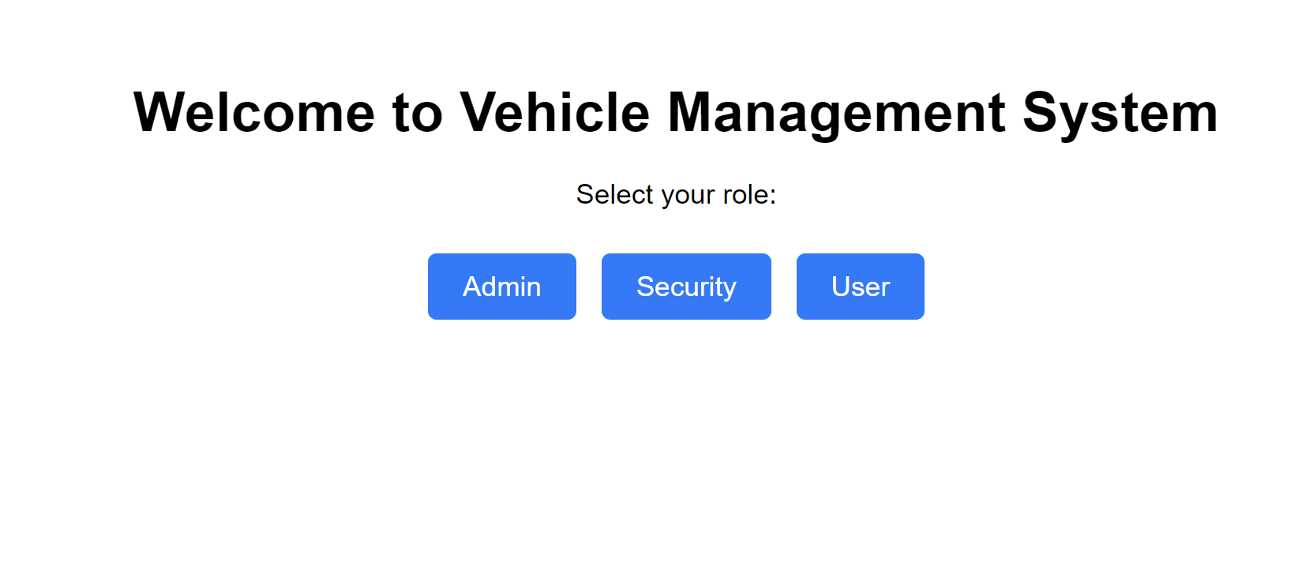

Slide 6
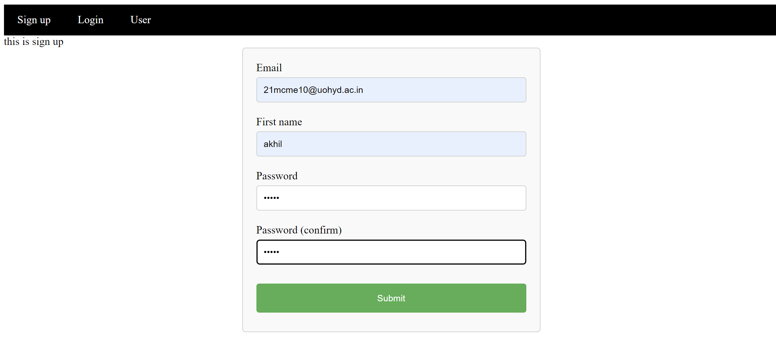

Slide 7
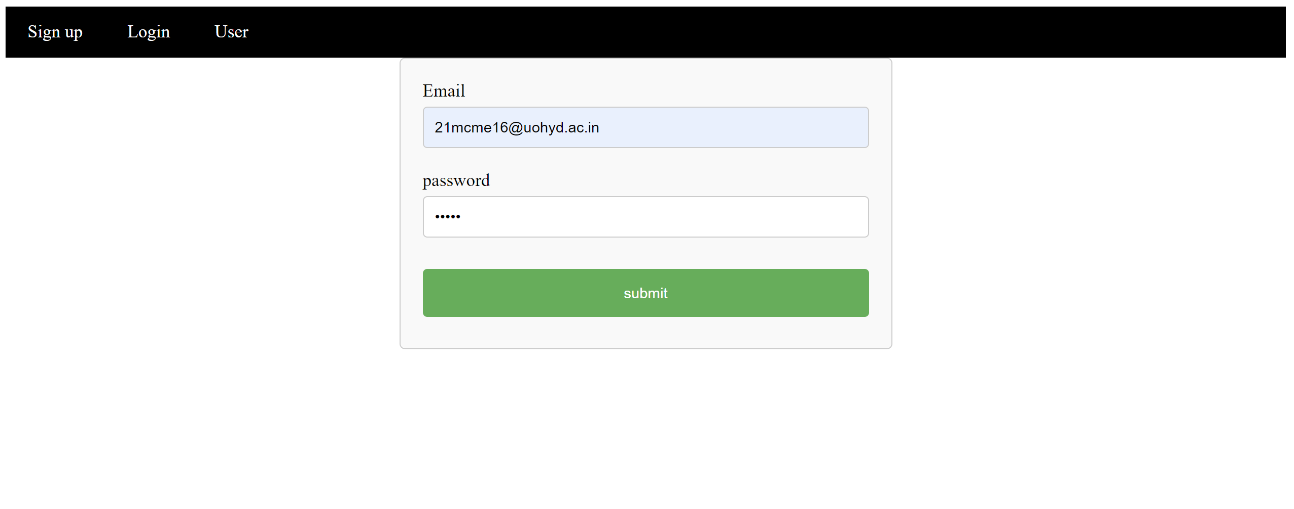

Slide 8
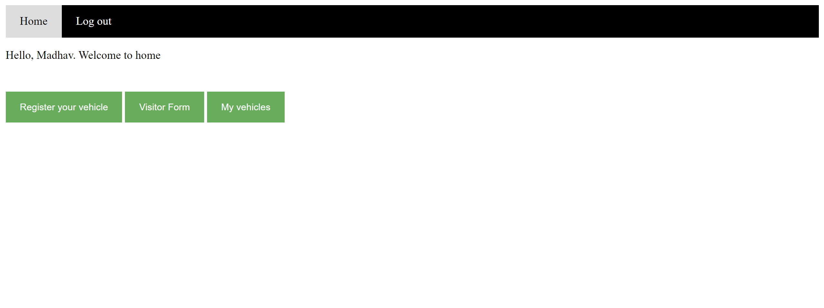

Slide 9
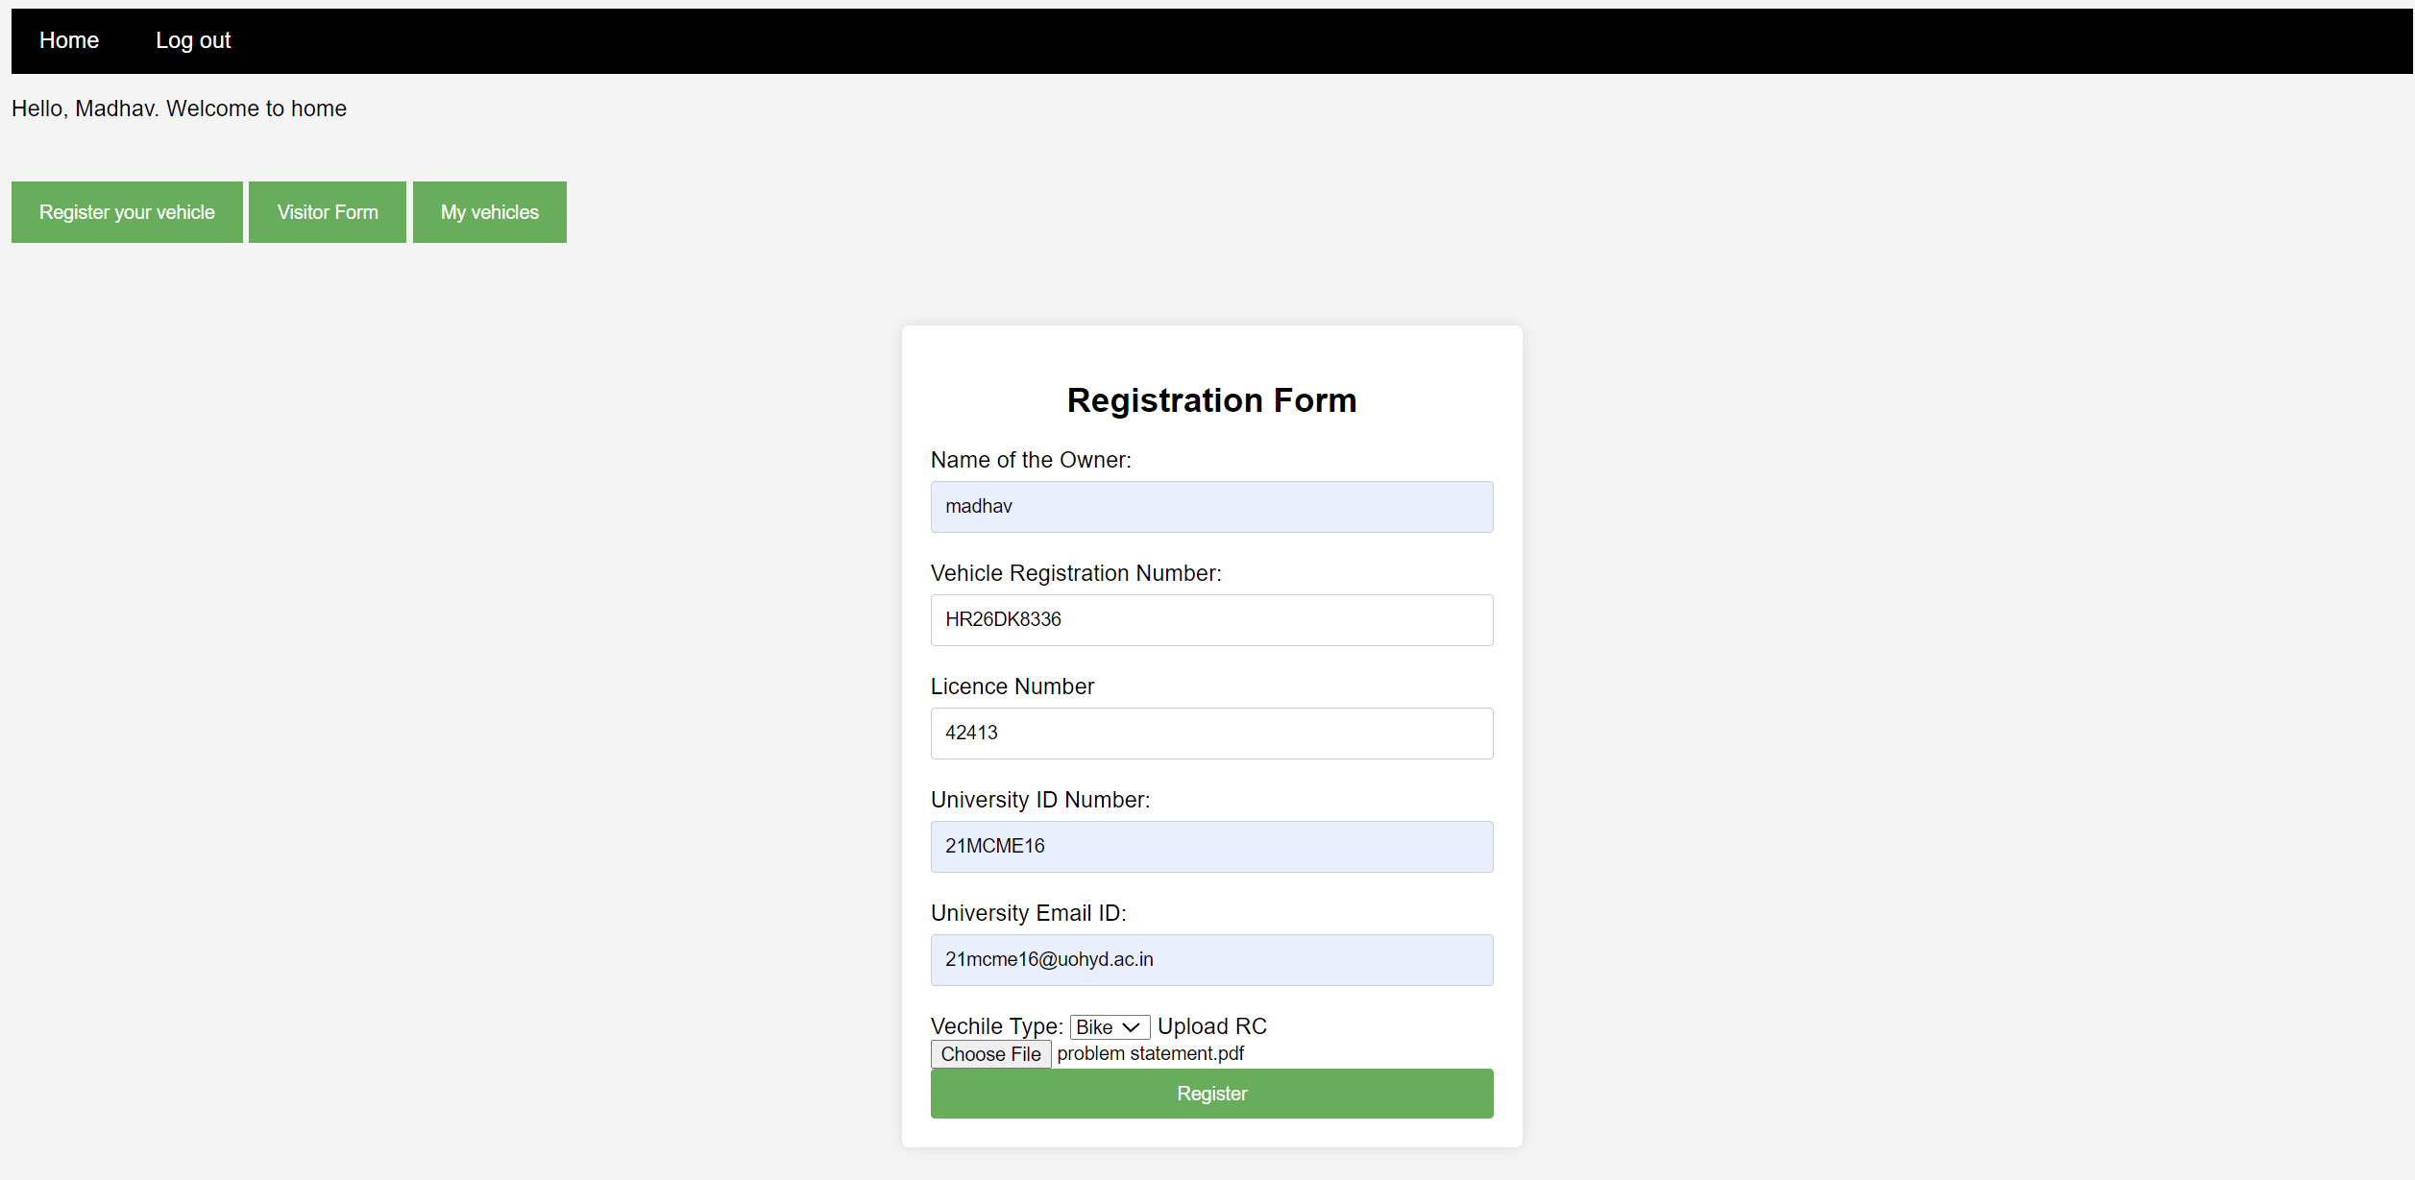

Slide 10
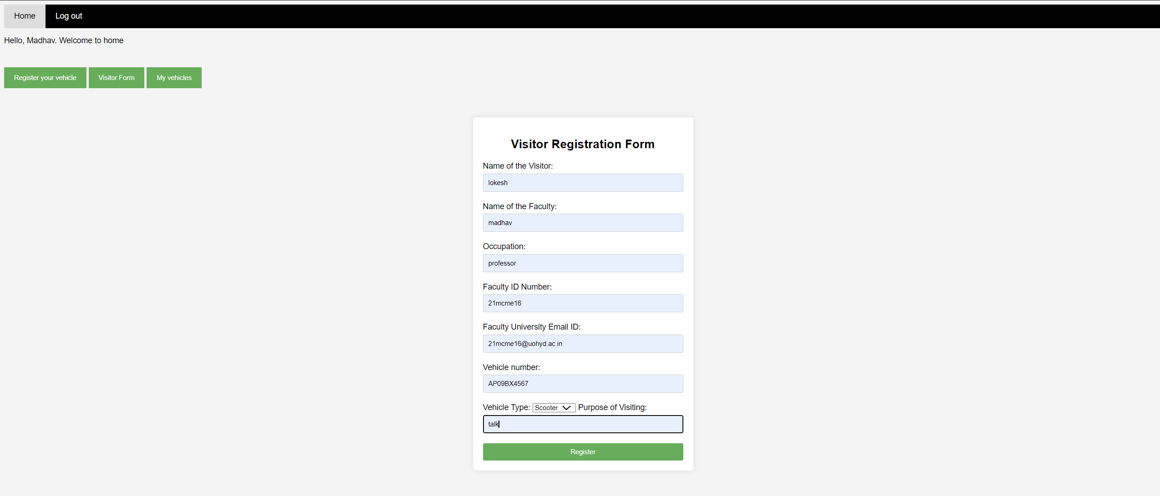

Slide 11
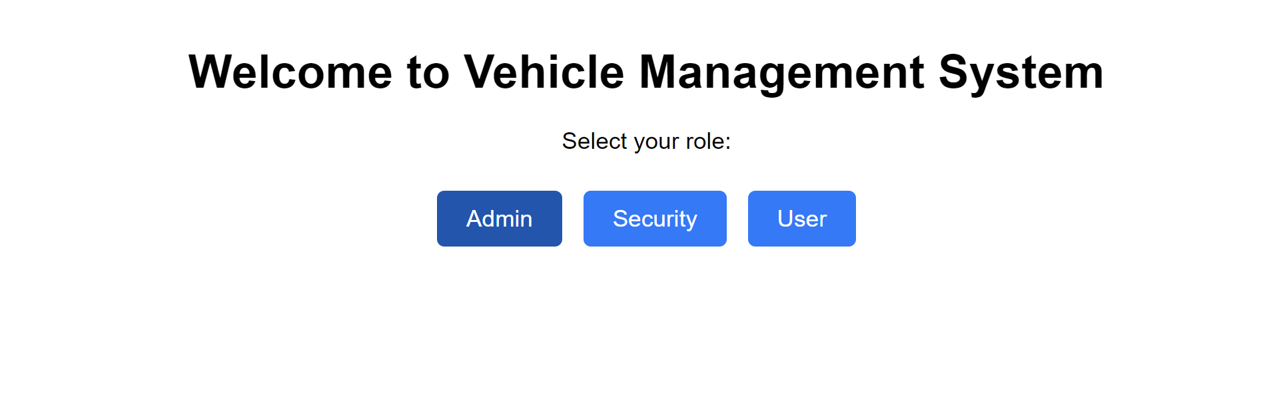

Slide 12
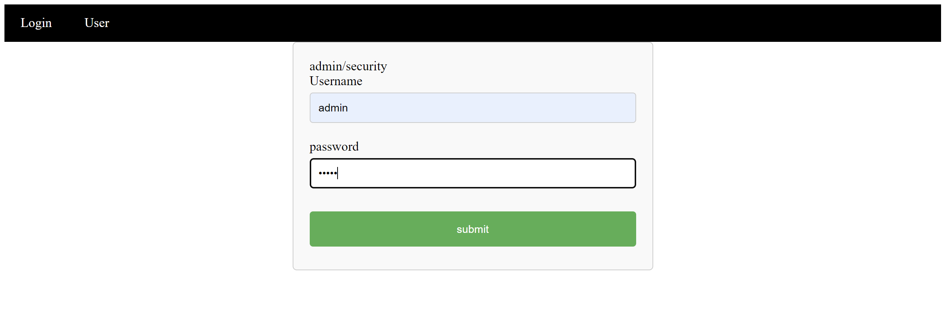

Slide 13
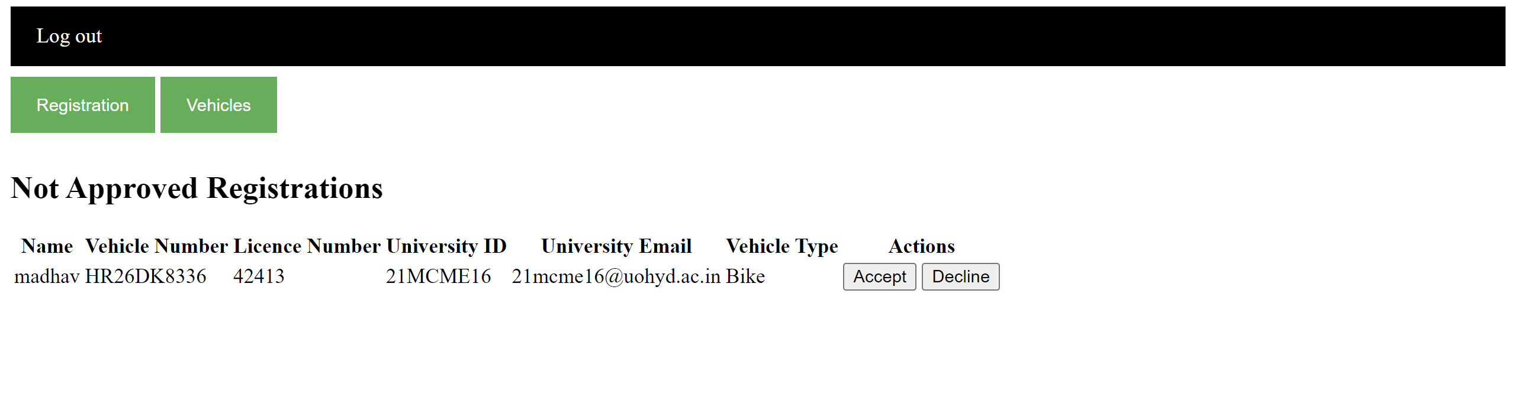

Slide 15
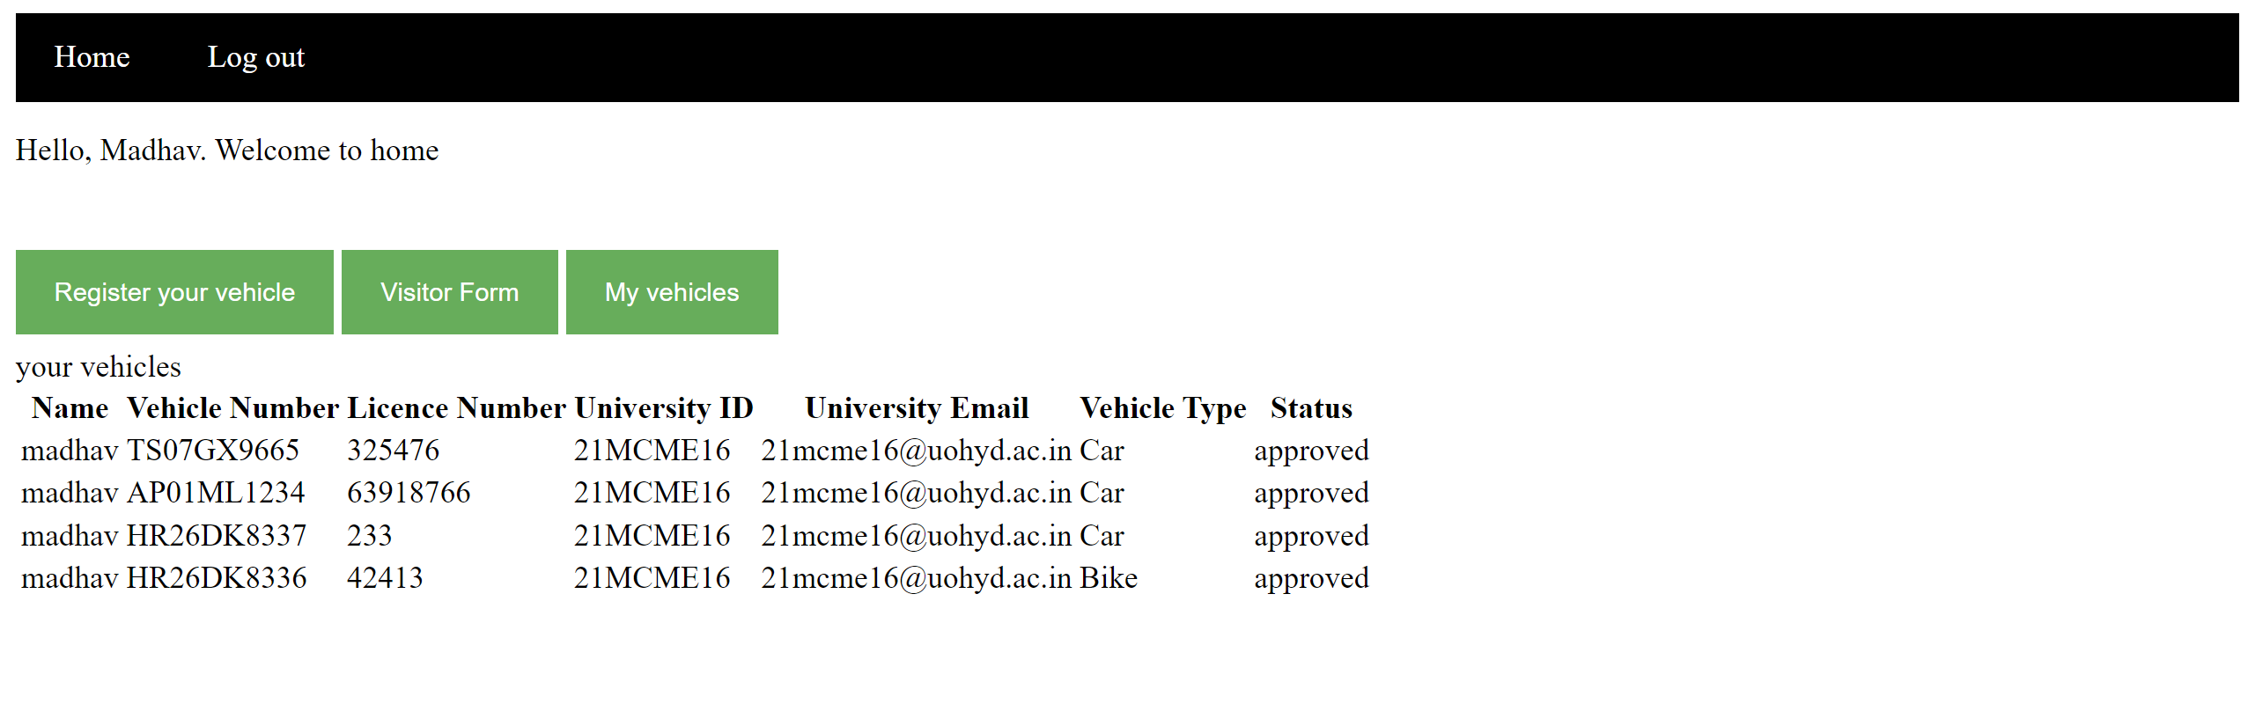

Slide 17
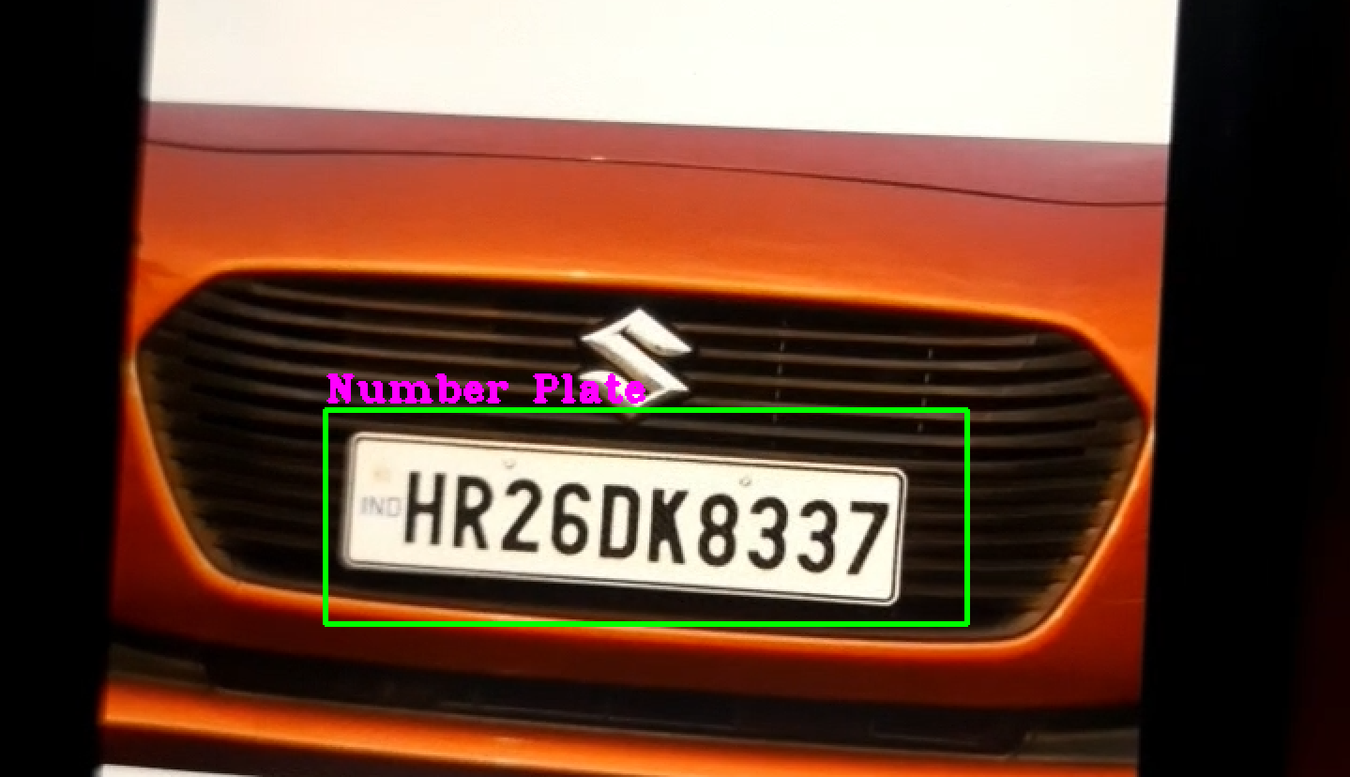
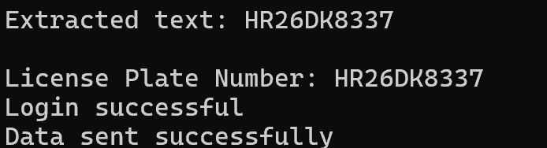

Slide 18
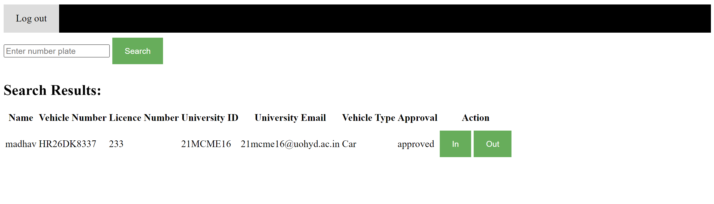

Slide 19
Thank you
21mcme16
21mcme26

